Slide 1
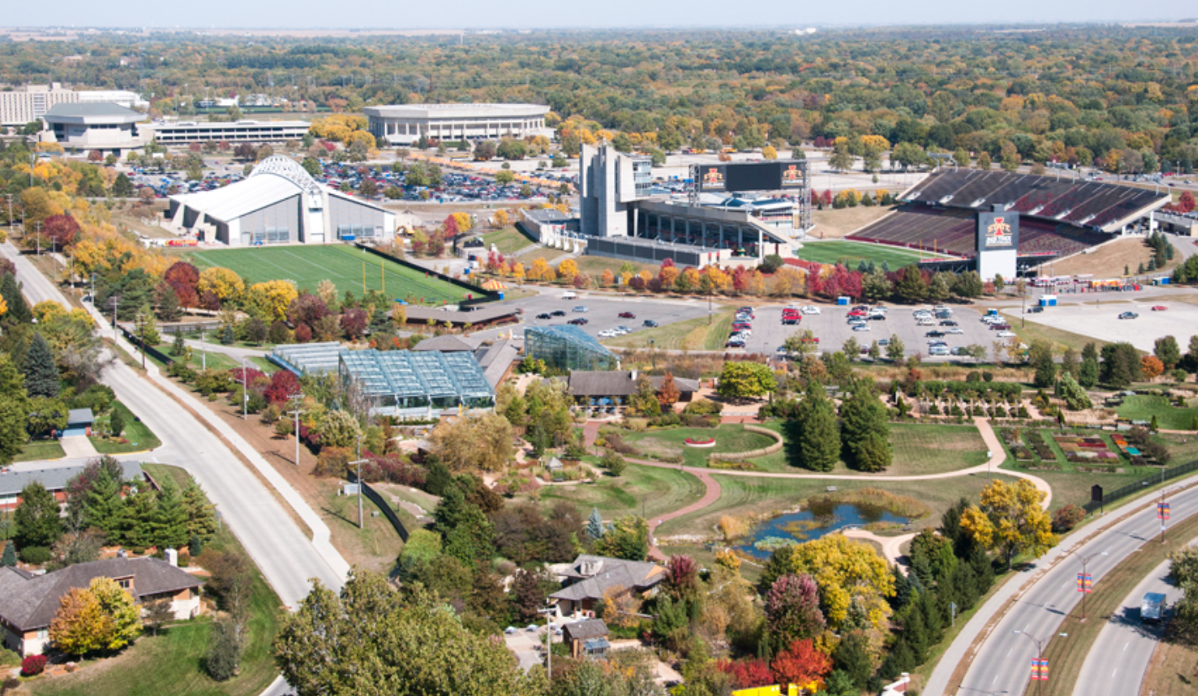




Housing Price Prediction
Kaggle Competition
The Avengers:
Andrew Dodd
Michael Goldman
Peter Yang
Roger Ren

Slide 2

Housing Price Prediction
Main objective:
Develop accurate models for estimating housing price in Ames, Iowa.
Sub-objectives:
Explore dataset, variable distributions, correlations, clean data.
Perform feature engineering.
Look for outside effects (inflation, seasonality, housing market).
Cluster dataset into sub-datasets.
Identify which variables significantly impacted sales price.
Select and tune models.
Create train, validate, and prediction pipeline.
Notes:
This can be a fairly quick slide, everybody knows the dataset...and the overall goal.

Slide 3
Presentation Overview
THE DATA
THE MODELS
THE PIPELINE
THE RESULTS
THE FUTURE
Notes:
This is a quick slide, outlines our presentation to the audience

Slide 4
THE DATA
Notes:
This is a quick slide, outlines our presentation to the audience

Slide 5
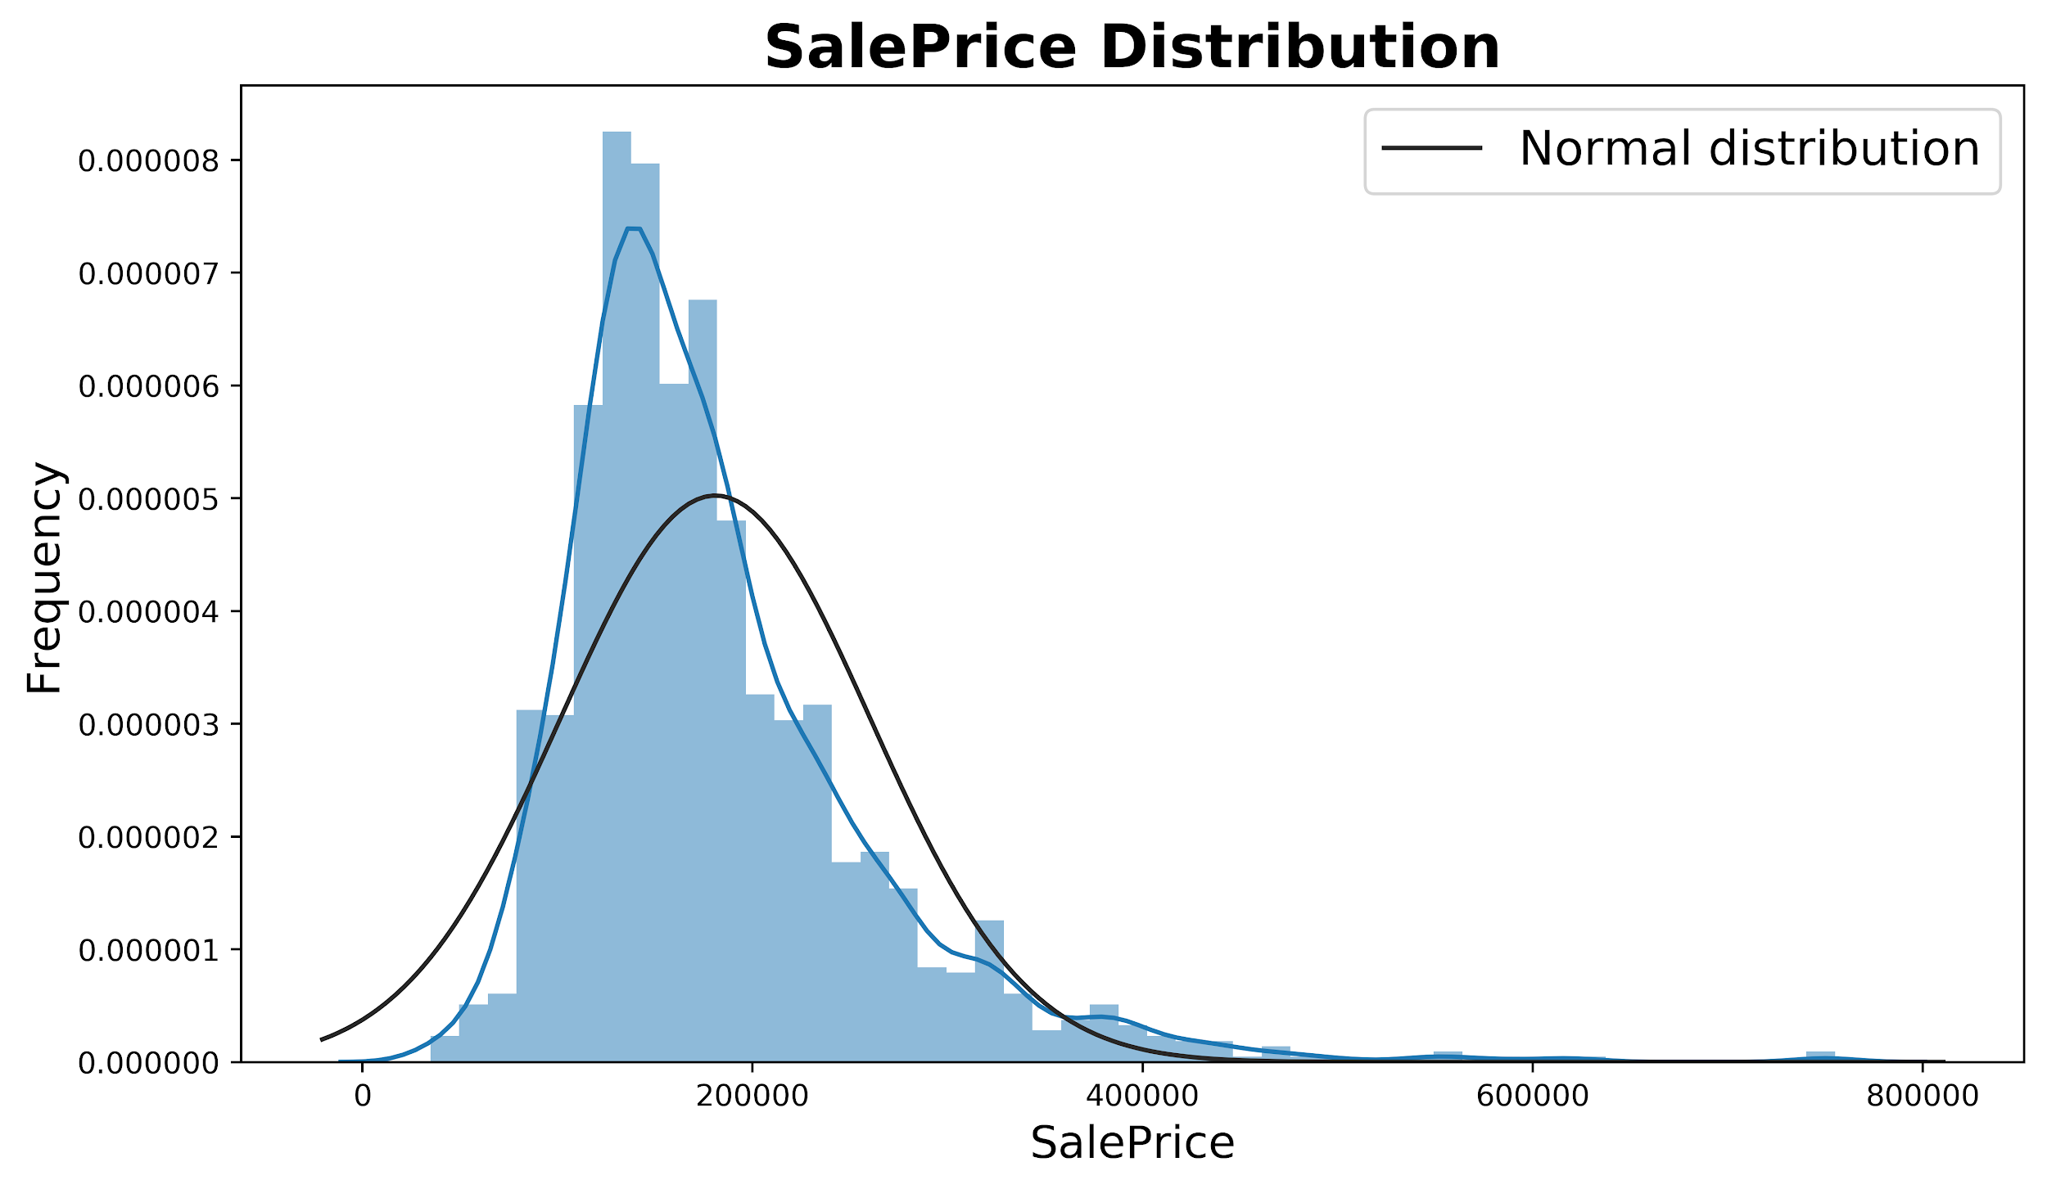
Dataset Exploration
SalePrice distribution
SalePrice versus numerical variables
SalePrice versus categorical variables
Correlation plot

Slide 6
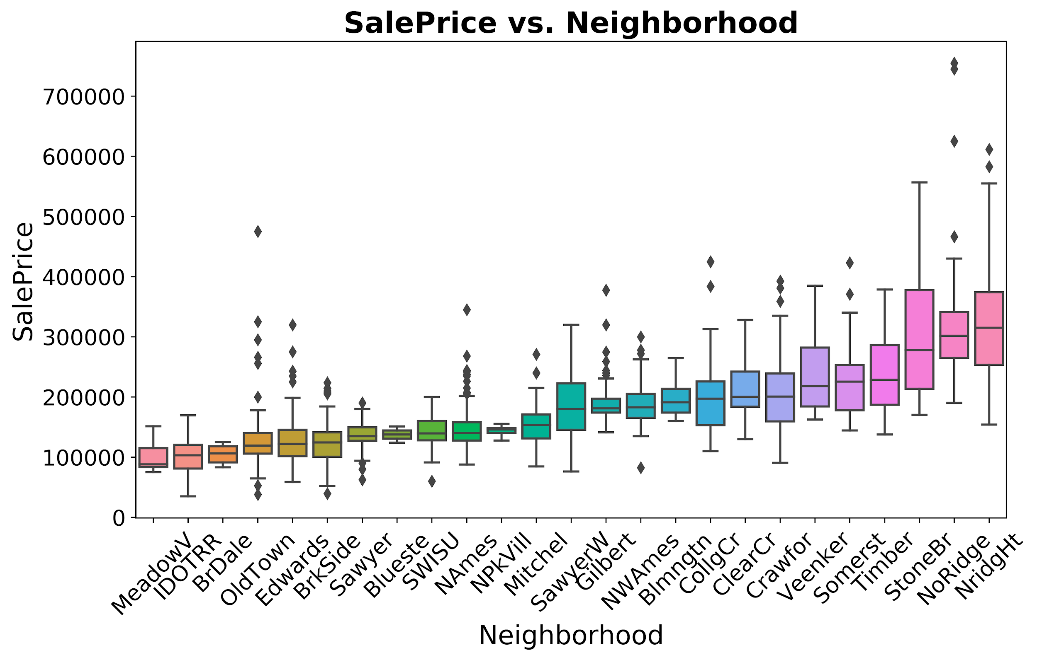
Dataset Exploration
SalePrice distribution
SalePrice versus numerical variables
SalePrice versus categorical variables
Correlation plot

Slide 7
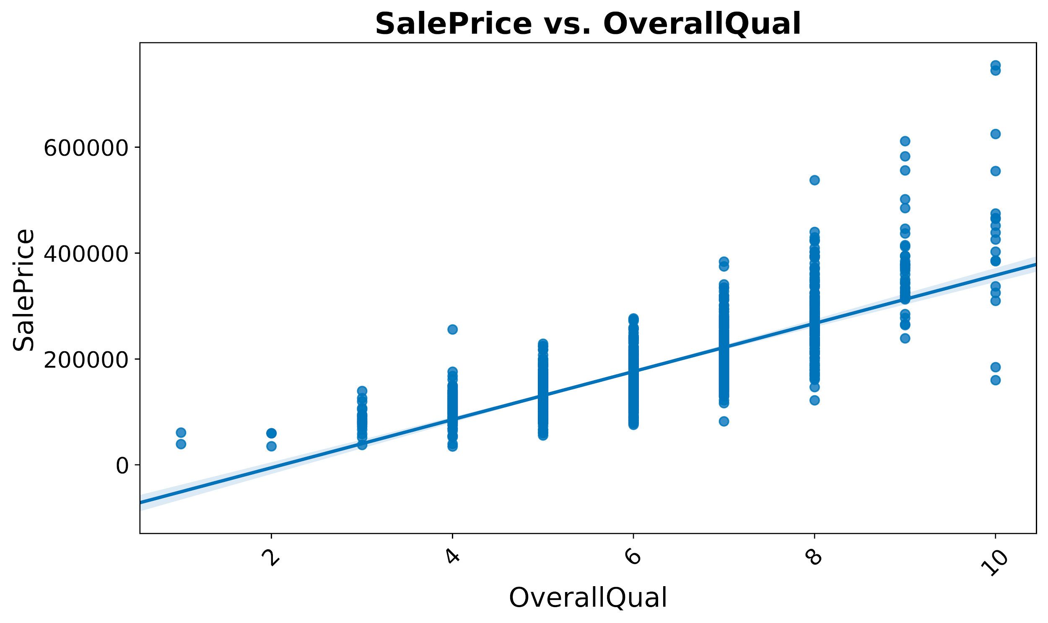
Dataset Exploration
SalePrice distribution
SalePrice versus numerical variables
SalePrice versus categorical variables
Correlation plot

Slide 8
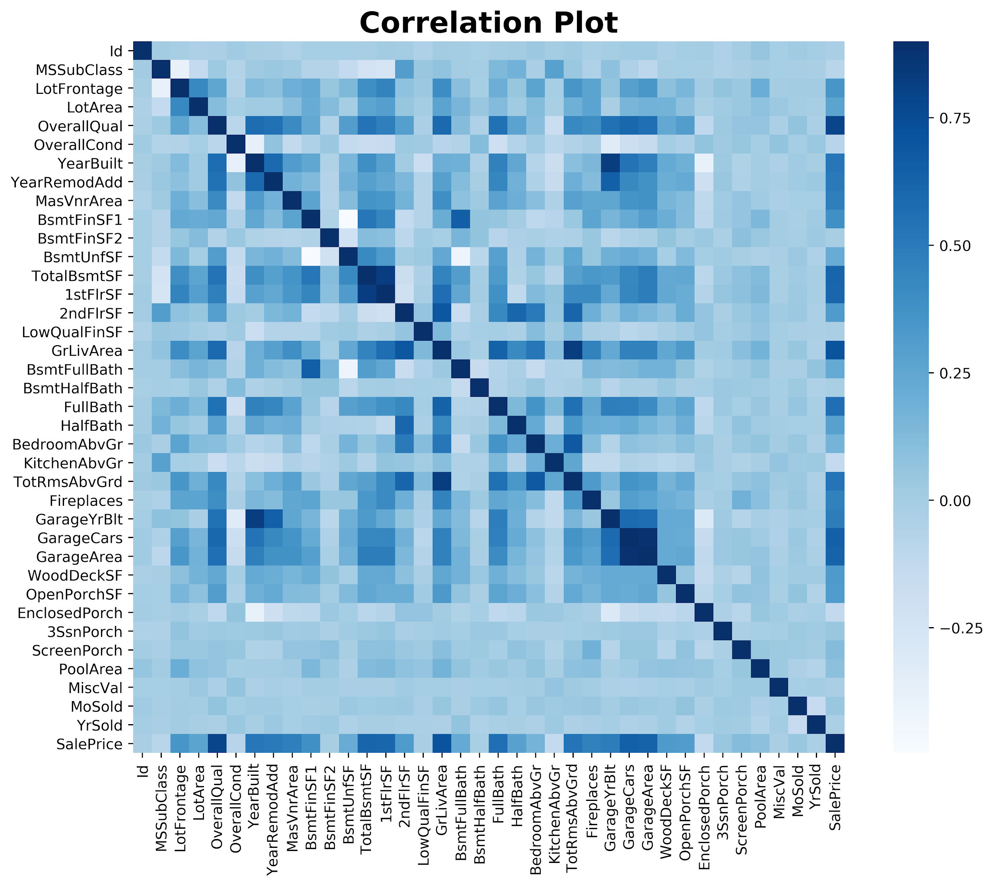
Dataset Exploration

Slide 9
Data Preparation: Overview
Agile Approach
Initial Model
Linear Model
Final Models
Increment #1
Increment #2
Increment #3
Raw Data
(1460 × 81)
Final
Result
Dummify Everything
Use only Numerical Data
Feature Engineering with only 1 dummy
1458 × 268
- Full information
- Removed 2 outliers
- Sparse, high dimensional
1458 × 84
- Major loss in information
- Dense, low dimensional
- Removed 2 outliers
1415 × 119
- Dense, low dimensional
- Low tolerance on outliers
- Min loss in information

Slide 10
Data Preparation: Pipeline
Data imputation
Log transform col. skew > 0.8
Ordinal categorical data mapping
Remove low variance col.
Raw Data
(1460 × 81)
Final Data
(1415 × 119)
Nominal data feature engineering
Remove duplicates of high collinearity col.
Dummify only if necessary
Remove outlier rows
Conservative feature engineering
Data Cleaning
Data Transforming

Slide 11
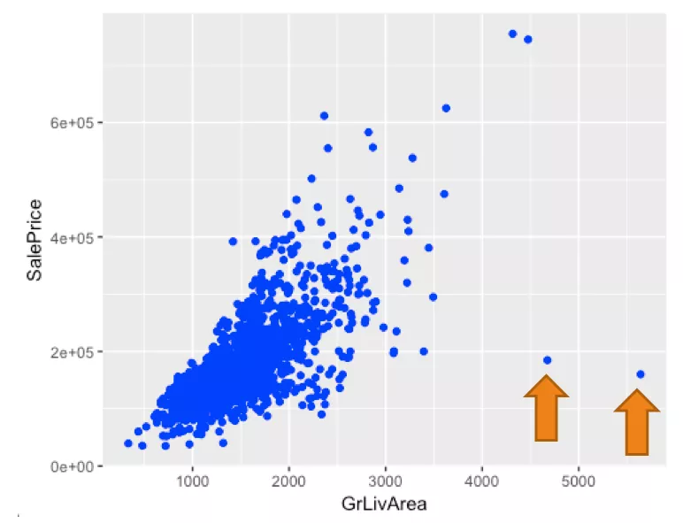
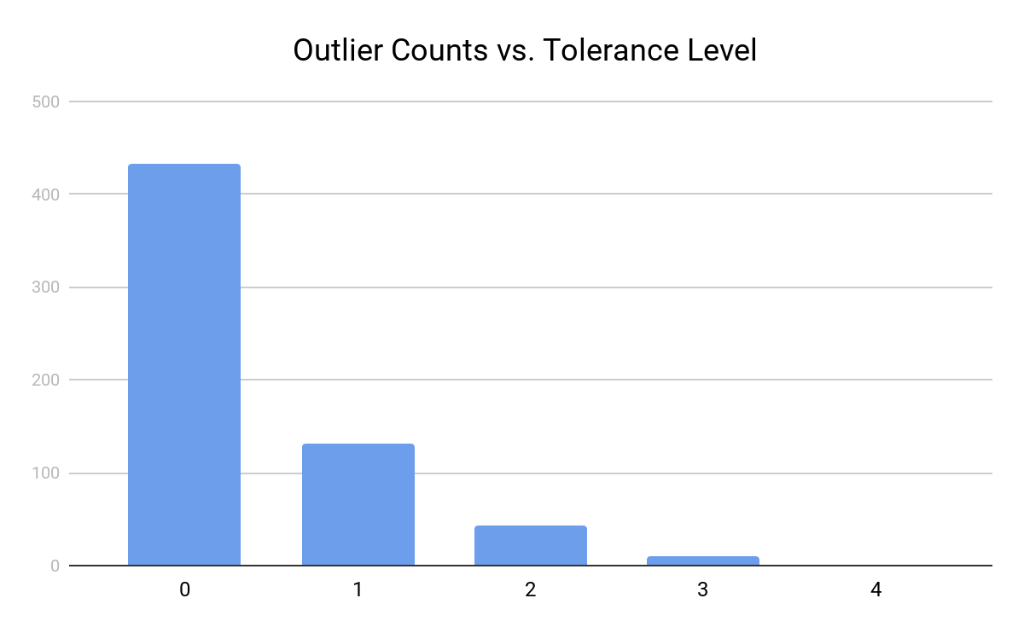
Data Preparation: Outliers Tolerance
- Remove outliers by plotting
- Some obvious ones
- Lack of systemic approach
- Remove outliers by +/- 3 std or 1.5 IQR
- Can set ‘tolerance level’
Log transform
Test +/- 3 std
Tolerance Analysis
Masked deletion

Slide 12
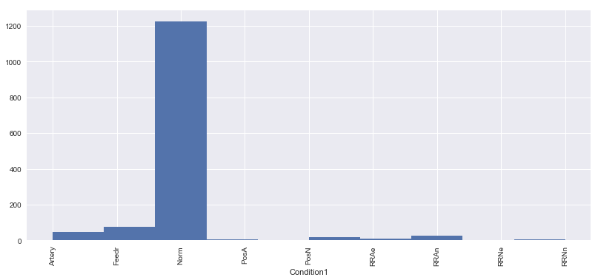
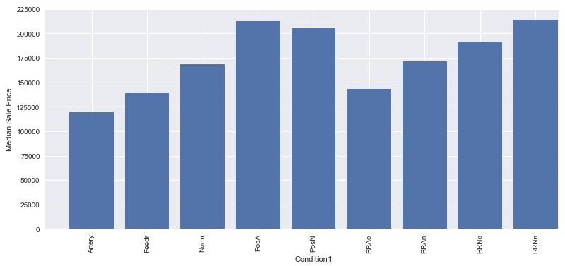
Data Preparation: Feature Engineering
Simple dummify:
- 1 col → 9 col
- Preserve all information
- Data set becomes sparse
Label by frequency:
- Lost information
- Arbitrary assignment
Significant factor:
- Preserve the information of a single / a few dominant factor(s)
Group and label:
- Keeps majority of information between ‘Factor’ and ‘SalePrice’
- Avoid unnecessary cols count increase
- Keeps dataset dense

Slide 13
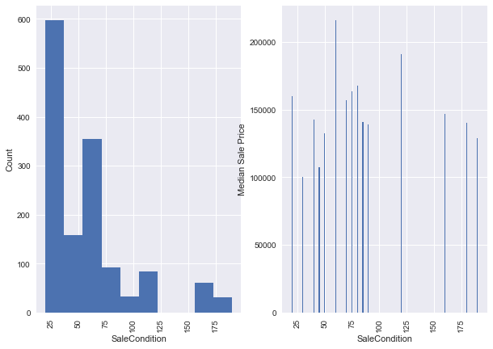
Data Preparation: Only 1 Dummy
‘MSSubClass’ column:
Appears to be numerical at first
It is actually categorical data
Do not exhibit ‘dominant’ factor

Slide 14
Time Trends
Inflation
The US inflation rate is approximately 2%
This might lead to a ~10% increase in houses over a 5 year span
Seasonality
Quantity of sales is higher in middle of year
Housing Market
Do the changes in the housing market (i.e. housing crash) affect the home prices in Ames, Iowa?

Slide 15
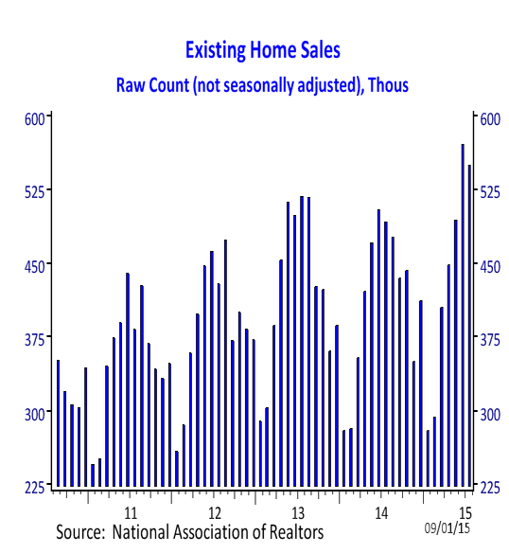
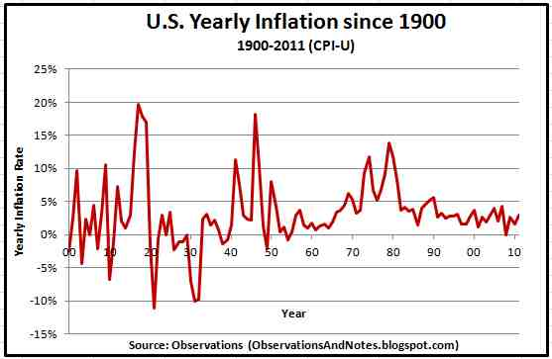
Seasonality changes in number of homes sold
Inflation rate versus year

Slide 16
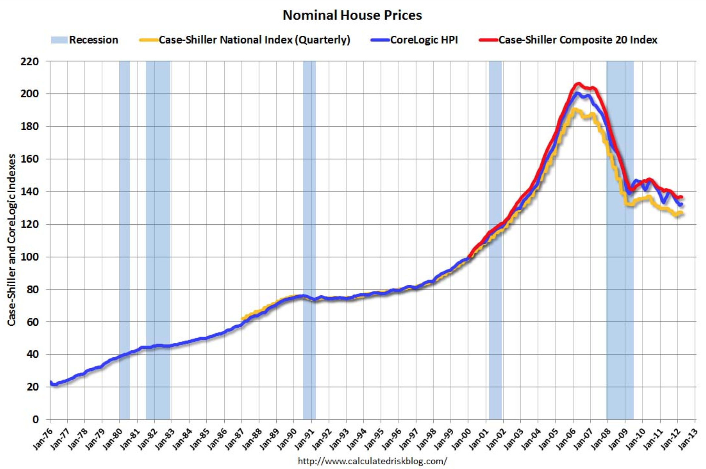
Do home prices trend strongly with time in the United States?

Slide 17

Do home prices trend strongly with time in the United States?

Slide 18
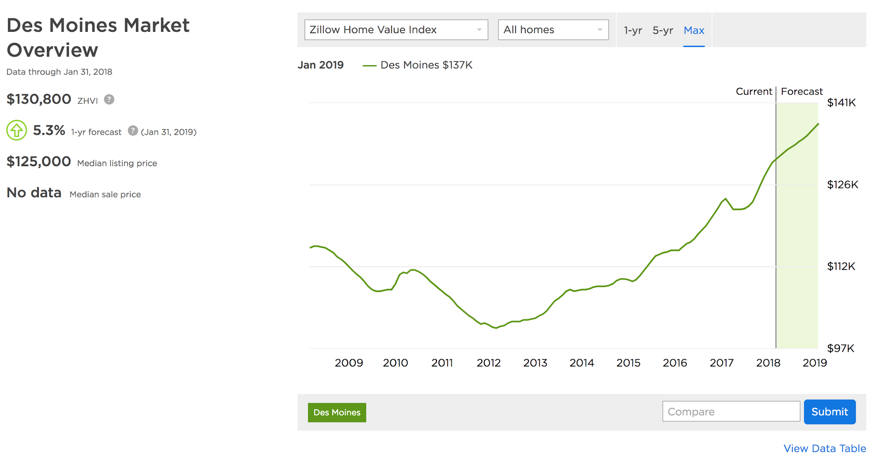
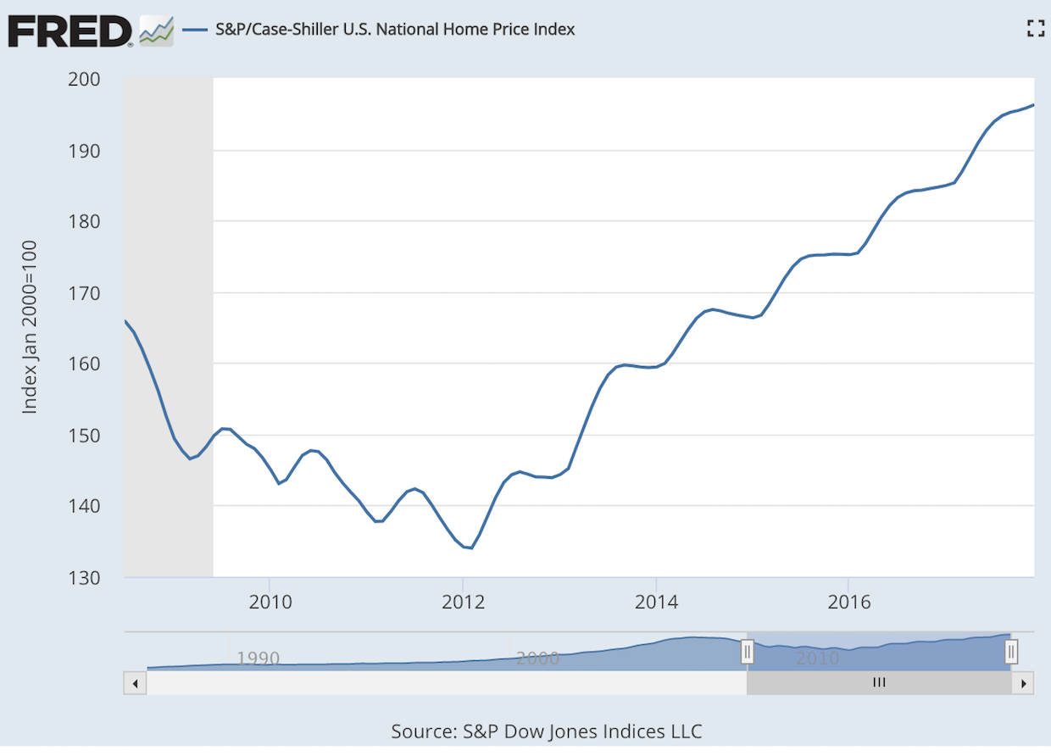
Does there seem to be a reasonable level of price correlation between Des Moines and US National Home Price Index?
Below left: Sales price in Des Moines, Iowa, 37 miles south of Ames.
Below right: US National Home Price index.

Slide 19
Does there seem to be a reasonable level of price correlation between Des Moines and US National Home Price Index?
Below left: Sales price in Des Moines, Iowa, 37 miles south of Ames.
Below right: US National Home Price index.

Slide 20
Modeling the effect of time...
Transform SalePrice column based on scaled inverse of US home index
Steps:
Create train/test split
Normalize SalePrice column w.r.t. time before fitting model.
Train/fit model using these normalized prices as y_train
Predict with this model
Reverse the transform
Try a variety of time trends and see which trends (if any) decrease the rmsle.
Did this work?

Slide 21

Modeling the effect of time...
Create transform using home price index to normalize SalesPrice column based on average US sales price
Steps:
Create train/test split
Normalize SalePrice column w.r.t. time before fitting model.
Train/fit model using these normalized prices as y_train
Predict with this model
Transform predictions back to original time varying world
Try a variety of time trends and see which trends (if any) decrease the rmsle
Did this work?
Notes:
Dataset was already scaled (unlikely)
Ames was isolated from the housing market crash

Slide 22
2. THE MODELS
Notes:
This is a quick slide, outlines our presentation to the audience

Slide 23
Models
Linear Models
Ridge
Lasso
Elastic Net
Random Forest
Boosting Models
Gradient Boosting
XGBoost
Light Gradient Boosting
Notes:
Neural net - between the amount of time to find the right parameters and model, as well as having to

Slide 24
Linear Models
Ridge
Want to minimize the impact of weak prediction coefficients.
Lasso
Want to drop unnecessary coefficients.
Elastic Net
A combination of both Lasso and Ridge.
Pros: They provide a good baseline and are relatively easy to implement.
Cons: Assume a linear relationship between variables and sale price. Suffer from multicollinearity.
Notes:
“Why did you choose your methodology?”
“How was this implemented?”
“Why does this work?”
“How did you verify results?”
“Why is this method superior to what is used in the industry?”

Slide 25
Random Forest
It is a large number of decision trees randomly selecting a limited number of factors at each split.
Pros:
Tends to not overfit when creating a large enough number of trees.
This works because all the individual trees are uncorrelated. Weaker predictive trees will average out to a more predictive stronger learner.
Cons:
Although it can handle multicollinearity for predictions and feature selection, we cannot be certain that the feature importance for multicollinearity factors is completely accurate.
With enough trees, this should be addressed, but can never be certain we have enough trees to address this.
Accuracy can suffer when predicting on data it has not seen before.
Since there are a maximum number of leaf nodes, there can only be that many different prices predicted.
Notes:
“Why did you choose your methodology?”
“How was this implemented?”
“Why does this work?”
“How did you verify results?”
“Why is this method superior to what is used in the industry?”

Slide 26
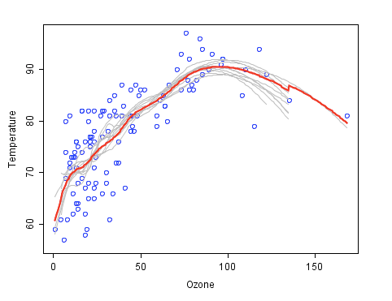
Random Forest - an example

Slide 27
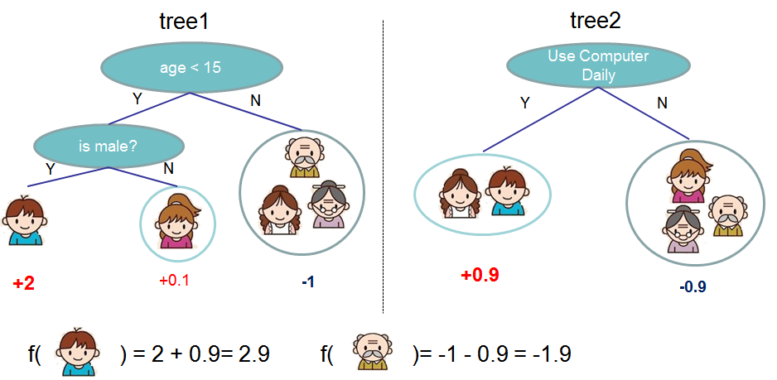
Boosting Methods
We used Gradient Boosting, XGBoost, Light Gradient Boosting
Predicting on the residual of a decision tree
Notes:
“Why did you choose your methodology?”
“How was this implemented?”
“Why does this work?”
“How did you verify results?”
“Why is this method superior to what is used in the industry?”

Slide 28
Boosting Methods
Pros:
Very accurate. As the number of trees increase, the closer our prediction will be to the true value.
A bit faster than random forest.
Cons:
Susceptible to overfitting the data, since it is predicting on the residual of a pervious tree.

Slide 29
Optimizers Used
Grid Search
Brute force method.
Put in a list of parameters and it generates the model with every combination of the parameters listed.
Bayesian Optimization
Initialize the regression based on values put into the regression.
Explores the model to find the global maximum based on the greatest widths of the confidence interval.
Exploits the the max iteratively.
Ran the optimizers twice. First time with a large scope search (eg: .001-10). Second time with a more accurate scope within the more ‘correct area’.

Slide 30
~Now Some Graphs~

Slide 31
TABLE OF CVs
Model | CV Score (approx.)
Lasso regression | .120
Ridge regression | .120
Elastic net regression | .120
Random Forest | .125
XGBoost | .118
GBoost | .118
LightGBM | .118

Slide 32
3. THE PIPELINE
Notes:
This is a quick slide, outlines our presentation to the audience

Slide 33
Object oriented modeling
Goal: Create a way to quickly implement, train, validate and create predictions from multiple models that can be stacked or averaged.
Model class
Functions:
init(model_type)
train_validate(data)
train_predict(data)
Stacking class
Functions:
init(metamodel_type)
train_validate_predict(base_model_predictions)
Notes:
Create a way to quickly implement, train, validate and create predictions from multiple models that can be stacked or averaged.
Why did average work better than xg/linear?

Slide 34
Stacking Approach
TRAIN
TEST
Lasso

Slide 35
Stacking Approach
CV1
CV2
CV3
CV4
TEST
Lasso
CV Score

Slide 36
Stacking Approach
CV1
CV2
CV3
CV4
TEST
Lasso
CV Score
Predictions

Slide 37
Stacking Approach
CV1
CV2
CV3
CV4
TEST
Lasso
Ridge
CV Score
Predictions
CV Score
Predictions

Slide 38
Stacking Approach
CV1
CV2
CV3
CV4
TEST
Lasso
Ridge
CV Score
Predictions
CV Score
Predictions
Stacking Model
(Linear, averaging, XGB)
CV Score
Predictions

Slide 39
Stacking Approach
CV1
CV2
CV3
CV4
TEST
Lasso
Ridge
Random For.
XGBoost
LightGBM
GBM
Score
Pred.
Score
Pred.
Score
Pred.
Score
Pred.
Score
Pred.
Score
Pred.
Stacking Model
(Linear, averaging, XGB)
CV Score
Predictions
Notes:
Connect score lines

Slide 40
Clustering Exploration: Overview
Train Cluster 1
Training Pipeline
Cluster 1 Model
Test Cluster 1
Partial prediction
Clean TRAIN Data
Train Cluster 2
Training Pipeline
Cluster 2 Model
Test Cluster 1
Test Data
Partial prediction
Train Cluster N
Training Pipeline
Cluster N Model
Test Cluster 1
Partial prediction
MERGE!
Final Prediction

Slide 41
Clustering Exploration: Pipeline
Clean TRAIN Data
PCA
N PCAs
- Trade off:
1. Cluster sample size
2. Homogeneous cluster
- High dimension cluster:
1. Reduce dimension
2. Keep AMAP info
- Cluster algorithms:
1. KMeans, Agglomerative, Gaussian Mixture...
2. Distance metrics:
['cityblock', 'cosine', 'euclidean', 'l1', 'l2', 'manhattan']
- Feature selection:
1. Filtering
2. Wrapping
Cluster with [2, 30] clusters
Silhouette Score -> Best K
Clean TRAIN Data
Cluster Labeled TRAIN
Cluster Method
Test Data
Cluster Labeled TEST

Slide 42
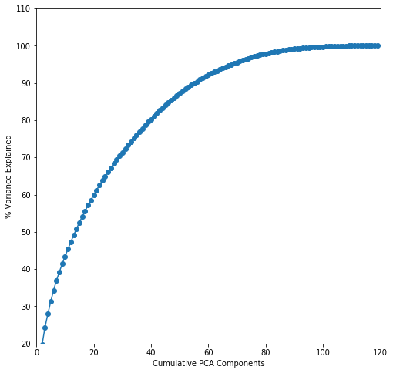
Clustering Exploration: Pipeline
Silhouette Score -> Best K
KMeans
AffinityPropagation
Cluster Labeled TRAIN
SpectralClustering
Cluster Labeled TEST
AgglomerativeClustering
GaussianMixture
54 PCAs explains 90%

Slide 43
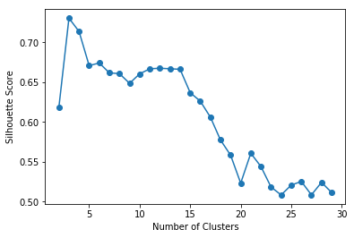
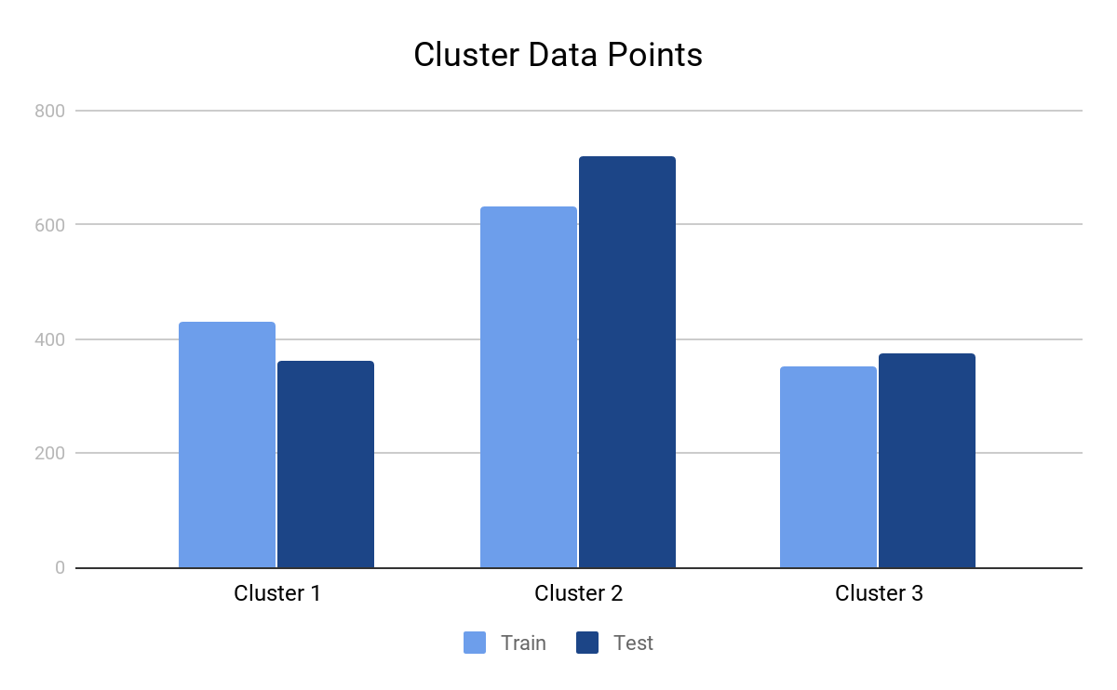
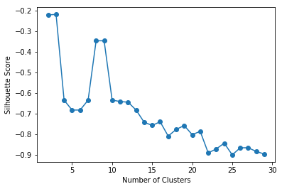
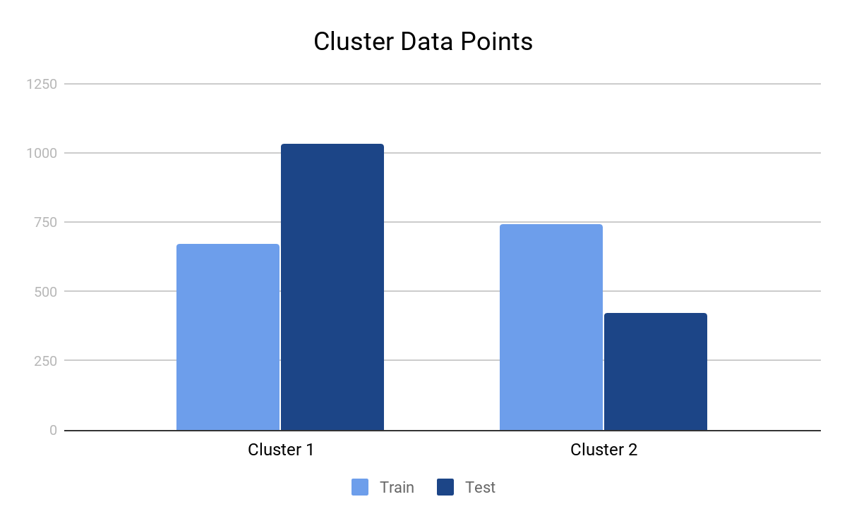
Clustering Exploration: Method and Metric
KMeans
3 Clusters
Agglomerative
2~3 Clusters

Slide 44
4. THE RESULTS
Notes:
This is a quick slide, outlines our presentation to the audience

Slide 45
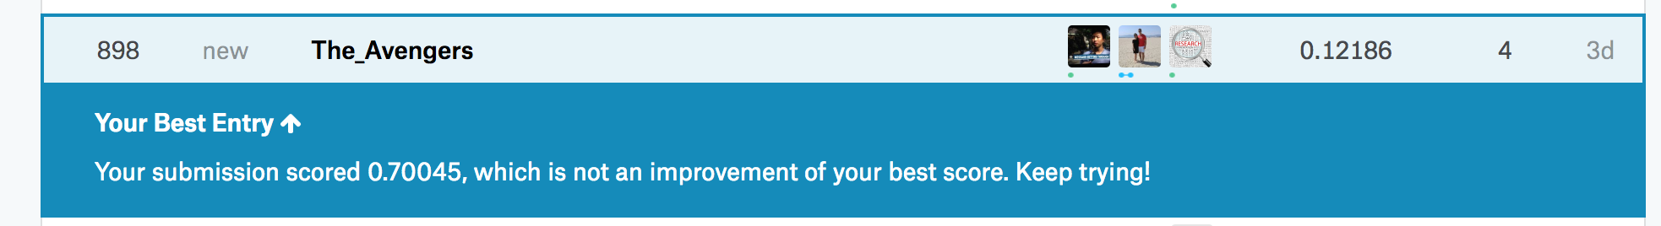
Results
Placed 898/4376, with a leaderboard score of .12186
This means our CV error was not a great match to our real test error
Notes:
It may have been better to have an OOB dataset (20% of data) to get more accurate approximations of our error. This means less data to train on though!
Did we overfit to our training set? Hard for us to say for sure...

Slide 46
5. THE FUTURE
Notes:
This is a quick slide, outlines our presentation to the audience

Slide 47
Future considerations
Investigate more into effects of time (are we sure there are not trends in housing price with time? Is this possible?)
Include an OOB error method (maybe put aside 20% of training data as a test set)
Focus more on an iterative feature engineering process
Using GitHub more effectively
Better team workflow (redundant work)

Slide 48
Questions?

